Slide 1
"Beware of deception": Detecting Half-Truth and Debunking it through Controlled Claim Editing
- Singamsetty Sandeep, Nishtha Madaan, Sameep Mehta, Varad Bhatnagar, Pushpak Bhattacharyya
https://arxiv.org/abs/2308.07973
Akanksha Dadhich
M.Tech. (RA)
Advisor: Dr. Pushpak Bhattacharyya
12th August, 2024

Slide 2
Problem Statement
Task: Detecting half truth and debunking the claim through controlled claim editing.
Input: Claim or an assertion C and an evidence E associated with these claims.
Output: Whether the claim is true or half-true or false.
Also if it’s half-true or false the author proposed editing pipeline which uses the evidence to edit the half-true or false claim and tries to generate an edited true claim C∗

Slide 3
Motivation
A half-truth is a statement that is partially true but intentionally omits important details that would significantly alter its meaning.
There are many forms of half-truth such as deception, exaggeration, propaganda, and intentionally hidden facts, etc.
Some individuals exploit these half truth for personal gain and mislead people. There has been methods that relied on human fact checkers but it limits in responding to this continuous stream of disinformation generating in today’s world.
Hence we need an automated half-truth detection model.

Slide 4
Literature Review
The author mentions work done in the domain of half-truth detection by Alhindi et al. (2018) where he introduced the LIAR-PLUS dataset and involved training the LSTM model to classify statements.
Guo et al. (2019) used sentiment analysis to detect the emotion conveyed by a claim and then used this to infer the claim’s
Apart from half-truth works have been done in detecting fake news and exaggerated and sensationalized news. Wright and Augenstein (2021) supervised learning approach that utilizes sentence-level features to detect exaggerated claims.
Gardner et al., 2020 introduced contrast sets which can be used to dubunk half-truth and then Ross et al., 2021 explored that structural-level properties of a claim can be used to edit it by semantically controlling the text generation.

Slide 5
Contribution
Extending the LIAR-PLUS dataset by adding an extra column called shortened justification, using textual entailment, and achieving a benchmark accuracy of 82% for the half-truth detection model.
Devising a novel claim editing technique which aided the T5 model, to outperform cutting-edge systems such as GPT2 by 82%, Roberta by 57%, PEGASUS by 42%, and Tailor by 23% with a success rate of 85% in the task of debunking claims and achieving an average content preservation score of 0.88 (on a scale of 0-1) on the edited claims.

Slide 6
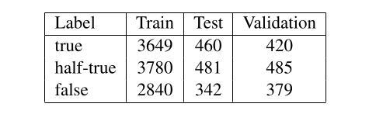
Dataset
The dataset used for half-truth detection was extended LAIR-PLUS dataset by adding adding the shortened justification column and the authors called it LIAR-PLUS-PLUS.
12,000+ human-labeled statements classified into six categories: true, mostly-true, half-true, barely-true, false, or pants-on-fire.
Data for training, validation, and test split is 10240, 1284, and 1283 instances respectively.
shortened justification created from textual entailment on the extracted justification column of the LIAR-PLUS dataset.
The composition of train, test, and validation
split of the LIAR-PLUS-PLUS dataset

Slide 7
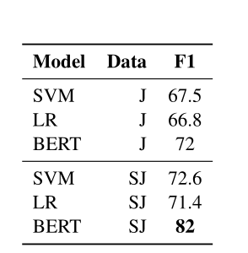
Technique [1/2]
Author used NLI model, and extracted shortened justifications by selecting sentences with the highest entailment or contradiction scores and the highest neutral scores.
This resulted in a maximum of two sentences per justification. Trained two BERT-based models on different datasets (LIAR-PLUS J model and LIAR-PLUS-PLUS SJ model).
Tested both models on the test set of the LIAR-PLUS-PLUS dataset and obtained an F1 score of 0.82 with the model trained on shortened justifications.
Regression and SVM models were used as baseline models.
The approach reduced model complexity and improved accuracy in detecting half-truths.
Performance of Half-Truth detection module
with various model-data combinations

Slide 8
Technique [2/2] Claim Editing Model Overview:
Used TAPACO paraphrase dataset, added SRL tags to 60,000 instances. Training: 50,000 instances, Validation/Test: 5,000 instances.
Training Process: Model: T5 (text-to-text transformer by Google).
Input: Semantic Role Labeling(SRL)-tagged paraphrased sentence + masked tokens.
Output: Original sentence with filled tokens.
Masking Strategy:
Tools: Textual entailment, Cosine similarity. Mask segments that contradict evidence or have lower similarity. Used NLI model to calculate contradiction scores.
Claim Editing Workflow:
Input: SRL-tagged counter (header) + masked claim.
Text Generation: Constrained Beam Search for controlled output.
Output: Up to five edited claims generated by T5.

Slide 9
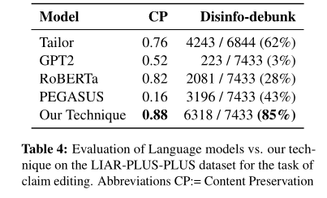
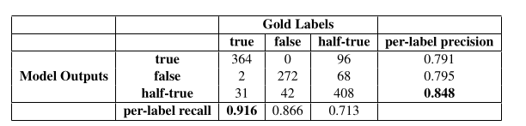
Results
The content preservation score is the BLEU score between the edited claim and the original claim.
BLEU Score: 0.88 (Scale 0-1)
The disinfo-debunk metric measures the percentage of claims that have been converted to true after editing them. Authors have used the BERT(SJ) model to detect the label of the edited claim and compute
the disinfo-debunk metric. Score: 85%
Meaning: Effectiveness in correcting false and half-true claims.
Confusion matrix and per-label precision and recall of the best-performing model, BERT-based sequence classifier, trained using the LIAR-PLUS-PLUS dataset
The macro average precision, recall, and F1 scores are 0.811, 0.831, and 0.82
Notes:
In writing, hedges are words or phrases that express uncertainty.
E.g. It will probably rain today.
“Probably” undercuts the much stronger claim that “it will rain today.” The word “probably” expresses uncertainty about the claim.
Negation is the act of making a term, phrase, or clause negative or opposite.
E.g. Hardly she speaks to me.
In this example, 'hardly' means almost never.

Slide 10
Conclusion
Accurate detection of half-truths with good accuracy aided by the creation of a shortened justification column.
T5 surpasses sophisticated techniques like Tailor in effectively debunking half-truths.
Utilizes SRL-tagged evidence and textual entailment for controlled claim editing.
Highest content preservation (BLEU score: 0.88).
Disinfo-debunk score of 85%, outperforming models like GPT-2, RoBERTa, and PEGASUS.

Slide 11
Future Work
For future work, the authors propose to build a reliable module to retrieve and summarize evidence from Google News for debunking disinformation.
Enhance the module for large-scale testing.
Develop a dataset with high-quality data on half-truths from news articles due to insufficient data in the LIAR-PLUS dataset impacts the model's accuracy.

Slide 12
Papers to read
https://www.ijcai.org/Proceedings/16/Papers/537.pdf
https://aclanthology.org/2023.acl-long.386/
https://arxiv.org/abs/2009.01047
https://aclanthology.org/2020.findings-emnlp.43.pdf
https://aclanthology.org/P17-2102/
https://aclanthology.org/D17-1317/
https://aclanthology.org/P17-2067/
https://www.ijcai.org/Proceedings/16/Papers/537.pdf

Slide 13
References:
Tariq Alhindi, Savvas Petridis, and Smaranda Muresan. 2018. Where is Your Evidence: Improving Fact-checking by Justification Modeling. In Proceedings of the First Workshop on Fact Extraction and VERification (FEVER), pages 85–90, Brussels, Belgium. Association for Computational Linguistics.

Slide 14
Week 2
Monotonic Reasoning
Non-monotonic Reasoning
In monotonic reasoning, once the conclusion is taken, then it will remain the same even if we add some other information to existing information in our knowledge base.
Earth revolves around the Sun.
In Non-monotonic reasoning, some conclusions may be invalidated if we add some more information to our knowledge base.
Logic will be said as non-monotonic if some conclusions can be invalidated by adding more knowledge into our knowledge base.

